Slide 1
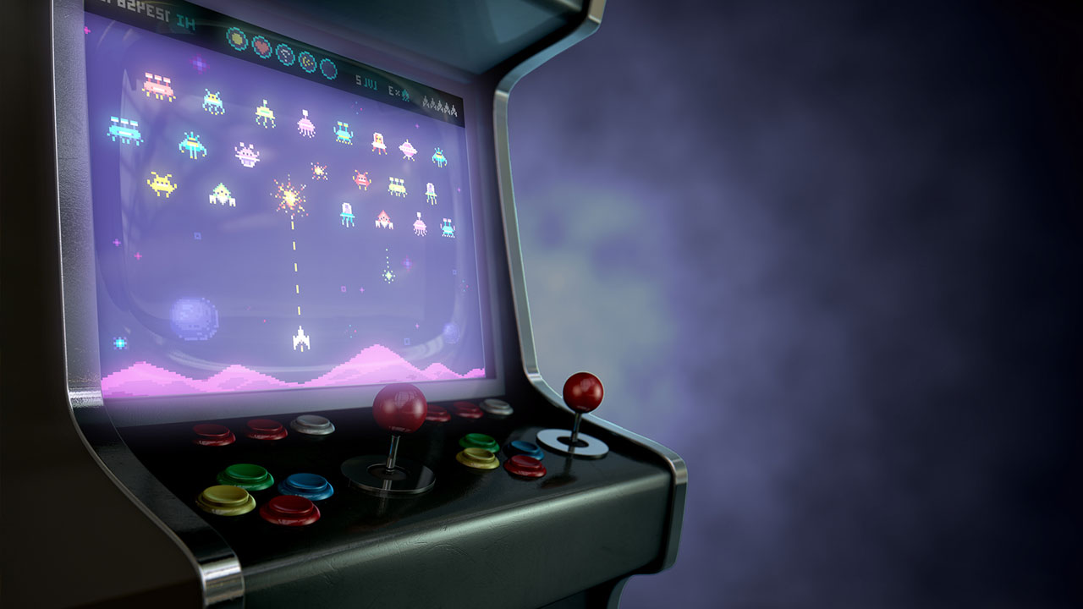
Interactive text-based game on Raspberry PI
By Ignacio Gonzalez, Timothy Wood and Andrew Garcia

Slide 2
Table of contents
01
04
02
05
03
06
Timeline
Challenges
Class Concepts
Improvements
Mechanics and Code Overview
Demo

Slide 3
Timeline
Define the project's scope, objectives, and requirements.
Arrange the different user-based decision pathways and flow of the program
Start setting up the main environment
Introduce multithreading and multiprocessing to handle different aspects of the game
Develop core game logic, setting, and features
Implement time-based events and test synchronization of multithreading
Implement and develop user interface for displaying all the game information and features
Refinement and implementation of final details, and Testing

Slide 4
Class Concepts
Locks | Creation of a lock for shared file, which allows both game scripts to communicate by reading file and writing to it.
Multiprocessing | We have 2 separate processes running, one of the Game and the other for the Map and Performance.
Multithreading | …
Synchronization Performance | Game with concurrent threads, which results in checking for overhead, lock contention, shared data protection and false sharing.

Slide 5
Mechanics and Code Overview
Here will be explanations of the code and mechanics with code snippets next to it.

Slide 6
Mechanics and Code Overview
Here will be explanations of the code and mechanics with code snippets next to it.

Slide 7
Challenges
Other Challenges…
Syncronization and Multiprocessing
Player Movement and in-game Mechanics
This was a big challenge as it took a big amount of time to set up…
…

Slide 8
Improvements
Improvement 1..
Info on that
Improvement 2..
Info on that
Improvement 3..
Info on that

Slide 9
Demo

